Slide 1


PMIT-6204: Cryptography & Steganography
for
3rd Semester of PMIT Program
Lecture File: 01
Overview of Cryptography
Prepared by:
Professor K M Akkas Ali
akkas_khan@yahoo.com, akkas@juniv.edu
Institute of Information Technology (IIT)
Jahangirnagar University, Dhaka-1342

Slide 2
Books Recommended:
Cryptography and Network Security
– Behrouz A Forouzan
Cryptography and Network Security Principles and Practice
– William Stallings

Slide 3
Lecture File-01
Overview of Cryptography
Topics to be Discussed
To know the general idea behind cryptography.
To be familiar with basic terminology related to cryptography.
To define the terms and the concepts of symmetric-key and asymmetric-key cryptography.
To distinguish between two cryptosystems: symmetric-key and asymmetric-key.
To emphasize the two categories of traditional ciphers: substitution and transposition ciphers.

Slide 4
What is Cryptography?
Cryptography is the study of secure communications techniques over un-trusted communication channel that allow only the sender and intended recipient of a message to view its contents.
The term ‘cryptography’ is derived from the Greek word kryptos, which means “secret writing”.
We can define cryptography as:
Cryptography is a physical process that scrambles information by rearrangement and substitution of content, making it unreadable to anyone except the person capable of unscrambling it.
Modern cryptography concerns itself with the following four objectives:
Confidentiality: The information cannot be understood by anyone for whom it was not intended.
Integrity: The information cannot be altered in storage or transit between sender and intended receiver without the alteration being detected.
Non-repudiation: The creator/sender of the information cannot deny at a later stage their intentions in the creation or transmission of the information.
Authentication: The sender and receiver can confirm each other's identity and the origin/destination of the information.

Slide 5
General Idea Behind Cryptography:
In cryptography, the message “Happy Valentine’s Day” may be concealed by-
substituting or replacing or shifting each symbol with another. For example, we can scramble the above message as “Gzoox Uzkdmshmd’r Czx” through shifting to one character before the actual character. If the symbols are digits, we can replace 3 with 7, 2 with 6 and son on.
changing or transposing the location of the symbols of each word of the message, such as “Pyaph Tniv’saelne Yda”.
Figure below illustrate the process.
Encrypt
Decrypt
Plaintext/Cleartext
Ciphertext
Decrypted text/ Plaintext
Happy Valentine’s Day
Gzoox Uzkdmshmd’r Czx
Happy Valentine’s Day
Sender: Alice
Recipient: Bob
Figure: General idea behind cryptography

Slide 6
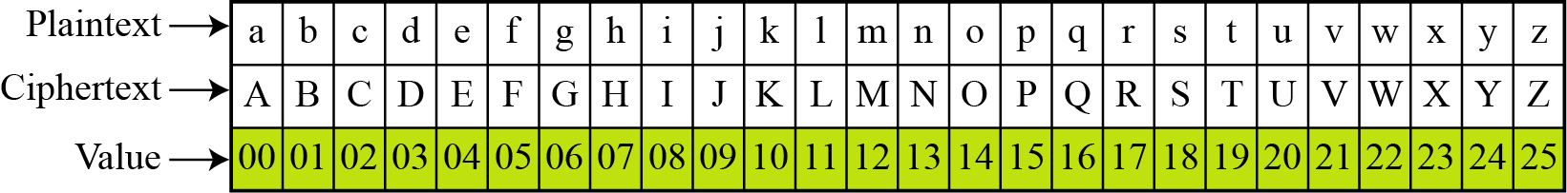
White Board

Slide 7
Parts of a Cryptographic System:
Generally, all cryptographic processes have four basic parts:
Plaintext
Ciphertext
Cryptographic Algorithm
Key

Slide 8
Basic Terminology Related to Cryptography
Plaintext/ Cleartext:
It is the original message that is being protected.
Ciphertext/ Encoded text/ Encrypted text:
It is the encoded message which is the result of transforming a plaintext using encryption.
Cipher/ Cryptographic Algorithm:
A cipher is an algorithm for performing encryption. It is a mathematical formula used to scramble the plain text to yield ciphertext. Converting plain text to ciphertext using the cryptographic algorithm is called encryption, and converting ciphertext back to plain text using the same cryptographic algorithm is called decryption.
Encrypt:
To transform a plaintext into ciphertext.
Decrypt:
To transform a ciphertext into plaintext.

Slide 9
Basic Terminology Related to Cryptography
Cryptanalysis:
It is the science of studying attacks against cryptographic schemes. Successful attacks may, for example, recover the plaintext (or parts of the plaintext) from ciphertext, substitute the parts of the original message, or forge digital signatures.
Cryptology:
Cryptography and cryptanalysis are often subsumed by the more general term cryptology.
Key:
A key is a set of mathematical value, formula or process that the cipher, as an algorithm, operates on. It determines how a plaintext message is encrypted or decrypted. The key is the only way to decipher the scrambled information.
A key is used to encrypt the message. Another or the same key is used to decrypt the message. As the size of key, used to encrypt a message, increases, so does the difficulty in deciphering the message.

Slide 10
Kinds of Cryptography
There are two main types of encryption:
Single key or secret key or symmetric-key cryptography
Public key or asymmetric-key cryptography
Symmetric-key cryptography is based on sharing secrecy.
Asymmetric-key cryptography is based on personal secrecy.
The choice of an encryption method depends on the
sensitivity of the data to be protected and
duration of the protection.

Slide 11
Idea Behind Symmetric-key Cryptography:
This is an encryption system in which both sender and receiver possess the same key for communication on the other direction.
Both parties can encrypt and decrypt messages with this same key. The sender and receiver must have a shared key set up in advance and kept secret from all other parties.
The encryption and decryption algorithms are inverse of each other.
The original message from Alice to Bob is called plaintext and the message that is sent through the channel is called the ciphertext.
Symmetric-key cryptography has been used throughout history by: Julius Caesar, German U-Boat commanders etc.

Slide 12
Idea Behind Symmetric-key Cryptography:
Postal Analogy of Symmetric-key Cryptography:
In the symmetric-key cryptography, the same key is used to both encrypt and decrypt message.
An analogy that can be used to understand the advantages of an symmetric system is to imagine two people, Alice and Bob, who are sending a secret message through the public mail. In this example, Alice wants to send a secret message to Bob, and expects a secret reply from Bob.
With a symmetric key system, Alice first puts the secret message in a box, and locks the box using a padlock to which she has a key. She then sends the box to Bob through regular mail (encryption).
When Bob receives the box, he uses an identical copy of Alice's key (which he has somehow obtained previously, maybe by a face-to-face meeting) to open the box, and reads the message (decryption). Bob can then use the same padlock to send his secret reply.
The problem with this method is how to give Bob a copy of the key that Alice used.

Slide 13
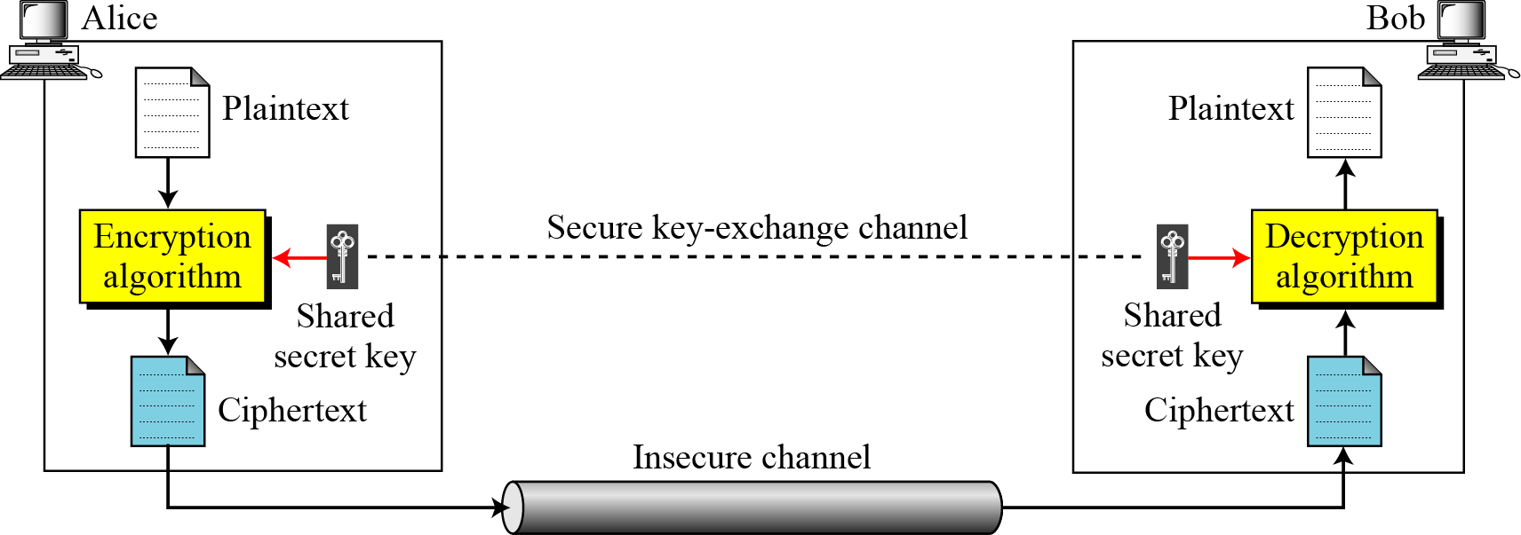
Idea Behind Symmetric-key Cryptography:
To create the ciphertext from the plaintext, Alice uses an encryption algorithm and a shared secret key.
To create the plaintext from ciphertext, Bob uses a decryption algorithm and the same secret key.
Figure below illustrates the single-key encryption.
Figure: General idea of symmetric-key cipher

Slide 14
Merits and Demerits of Symmetric-key Cryptography:
Merits:
Symmetric key algorithms are computationally less intensive than asymmetric key algorithms. In practice, this means that a quality asymmetric key algorithm is much slower than a quality symmetric key algorithm.
Symmetric encryption satisfies the requirement of message content security, because the content can not be read without the shared secret key.
Demerits:
It can pose two problems:
The key must be delivered securely to the two parties involved.
If a business has 10 business vendors, it needs 10 different single keys unique to each vendor. Key distribution for multiple keys can be a hassle. Choosing, distributing, and storing keys without error and without loss is difficult.

Slide 15
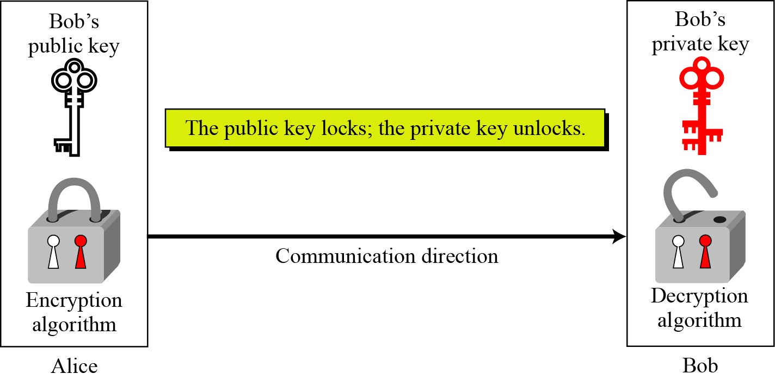
Idea Behind Asymmetric-key Cryptography:
It is an encryption system in which two mathematically related keys are used for encoding and decoding the message. Of the two keys, one is called public key that any one can know. Another is called private key that only the owner knows.
Public key can encrypt information, whereas, the private key can decrypt it. The private key is assigned to one designated owner, but the public key can be announced to the world. It can be published in a newspaper, on a server, on a website, or via a service provider so that anyone can encrypt with it.
The most common public-key algorithm is the RSA cryptosystem, named for its inventors (Rivest, Shamir, and Adleman). Besides RSA, other public-key cryptosystems are Rabin cryptosystem, ElGamal cryptosystem, elliptic curve cryptosystem (ECC) etc.
Figure: Locking and unlocking in asymmetric-key cryptosystem

Slide 16
Idea Behind Asymmetric-key Cryptography:
Postal Analogy of Asymmetric-key Cryptography:
In the asymmetric-key cryptography, there are two keys - a public key and a private key.
An analogy that can be used to understand the advantages of an asymmetric system is to imagine two people, Alice and Bob, who are sending a secret message through the public mail. In this example, Alice wants to send a secret message to Bob, and expects a secret reply from Bob.
In an asymmetric key system, Bob and Alice have separate padlocks- one is open and another is secret.
First, Alice asks Bob to send his open padlock to her through regular mail, keeping his key to himself. In other words, Bob sends Alice his public key.
When Alice receives it she uses it to lock a box containing her message, and sends the locked box to Bob.
Bob can then unlock the box with his key (which is only private to him) and read the message from Alice.
To reply, Bob must similarly get Alice's open padlock to lock the box before sending it back to her.
Figure: Locking and unlocking in asymmetric-key cryptosystem

Slide 17
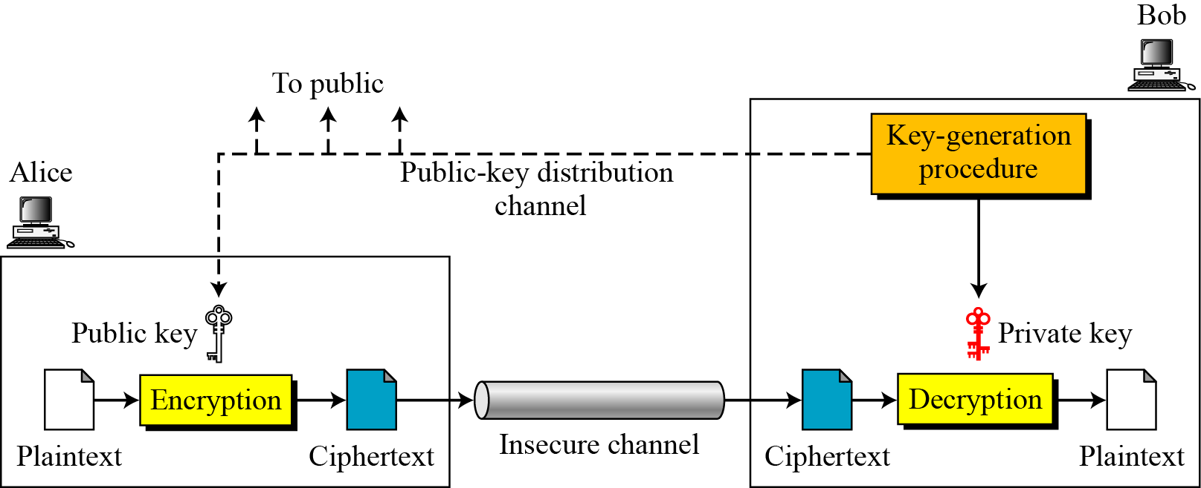
Idea Behind Asymmetric-key Cryptography:
Asymmetric-key cryptography uses two separate keys: a private key and a public key.
Both sending and receiving entity have their own key pairs, where one key (usually public key) is used to encrypt message and another key (usually private key) is used to decrypt message. In other words, a message encrypted with a public key can be decrypted only with the corresponding private key.
Alice uses Bob’s public key to send encrypted message to Bob.
Bob uses his private key to decrypt message sent by Alice.
Bob needs only one private key to receive all correspondence from anyone in the community, but Alice needs n public keys to communicate with n entities in the community, one public key for each entity.
In asymmetric-key cryptography, plaintext and ciphertext are treated as integers. Before encryption, the message must be encoded as an integer (or a set of integers). The integer (or set of integers) must be decoded into the message after decryption.
Figure below illustrates the general idea behind asymmetric-key cryptography.
Figure: General idea of asymmetric-key cryptosystem

Slide 18
Idea Behind Asymmetric-key Cryptography:
Encryption/Decryption
The encryption and decryption in asymmetric-key cryptography are mathematical functions applied over the numbers representing the plaintext and ciphertext.
The ciphertext can be thought of as C = f (K_{public} , P)
The plaintext can be thought of as: P = g(K_{private} , C)
The encryption function f is used only for encryption.
The decryption function f is used only for decryption.
Figure: General idea of asymmetric-key cryptosystem

Slide 19
Modes of Usages of Asymmetric-key Cryptography:
In asymmetric-key cryptography, the public-private key-pairs can be used in two different ways:
To provide message confidentiality
To prove the authenticity of the message originator

Slide 20
Modes of Usages of Asymmetric-key Cryptography:
Providing Message Confidentiality or Message Privacy:
In this way of private-public key-pairs, data encrypted with the public key can only be decrypted with the corresponding private key.
Here, data is encrypted by the sender using the recipient's public key.
The public key is freely distributed.
Data can only be decrypted by the recipient's private key.
The private key is kept secret.
Therefore, the data or message remains confidential or private until decoded by the recipient with his/her private key.
Example:
Suppose that, Rassel wants to send a confidential message to Ellen. He would first acquire Ellen’s public key. Then he would use that key to encrypt the message and send it to her. If a third party intercepts the message and tries to decode it using Allen’s public key, it would not work. Because only Ellen has the private key, only she can decrypt it. If Allen wants to send a reply, she would use Rassel’s public key and Rassel would use his private key to decrypt it.

Slide 21
Modes of Usages of Asymmetric-key Cryptography:
Providing Authenticity of the Message Originator:
In this way of private-public key-pairs, data encrypted with the private key can only be decrypted with the public key.
Use asymmetric-key encryption for authentication.
Here, data is encrypted by the sender using his/her private key.
The private key is kept secret.
Data can only be decrypted by anyone using sender's public key.
The public key is freely distributed.
Because you are the only person who can encrypt an electronic document with your private key, anyone using your public key to decrypt the message is certain that the message really came from you.
Example:
For example, Rassel is an e-customer. He wants to be sure that he is dealing with a legitimate vendor. Similarly, the vendor wants to make sure that Rassel is really Rassel.

Slide 22
Symmetric-key Vs. Asymmetric-key Cryptography:
Key-point | Symmetric-key | Asymmetric-key
Invention | More than 2000 years (at least in primitive form) | In the mid 1970’s
No. of key(s) used | Symmetric-key cryptography uses a single shared secret key. | Asymmetric-key cryptography uses two separate keys: one private and one public.
Is same key used for both encryption and decryption? | Symmetric-key cryptography is based on sharing secrecy, i.e., both the sender and receiver posses the same single private key that must be shared between them. | but asymmetric-key cryptography is based on personal secrecy, i.e., both the sender and receiver posses two key: One is the private key of the sender and another is the public key of the receiver. The same is applicable for the receiver.
Key length | This approach uses shorter keys | This approach uses longer keys
Notes:
What are the advantages and disadvantages of public-key cryptography compared with secret-key cryptography?
The primary advantage of public-key cryptography is increased security and convenience: private keys never need to be transmitted or revealed to anyone. In a secret-key system, by contrast, the secret keys must be transmitted (either manually or through a communication channel) since the same key is used for encryption and decryption. A serious concern is that there may be a chance that an enemy can discover the secret key during transmission.
Another major advantage of public-key systems is that they can provide digital signatures that cannot be repudiated. Authentication via secret-key systems requires the sharing of some secret and sometimes requires trust of a third party as well. As a result, a sender can repudiate a previously authenticated message by claiming the shared secret was somehow compromised by one of the parties sharing the secret. For example, the Kerberos secret-key authentication system involves a central database that keeps copies of the secret keys of all users; an attack on the database would allow widespread forgery. Public-key authentication, on the other hand, prevents this type of repudiation; each user has sole responsibility for protecting his or her private key. This property of public-key authentication is often called non-repudiation.
A disadvantage of using public-key cryptography for encryption is speed. There are many secret-key encryption methods that are significantly faster than any currently available public-key encryption method. Nevertheless, public-key cryptography can be used with secret-key cryptography to get the best of both worlds. For encryption, the best solution is to combine public- and secret-key systems in order to get both the security advantages of public-key systems and the speed advantages of secret-key systems.
Public-key cryptography may be vulnerable to impersonation, even if users' private keys are not available. A successful attack on a certification authority will allow an adversary to impersonate whomever he or she chooses by using a public-key certificate from the compromised authority to bind a key of the adversary's choice to the name of another user.
In some situations, public-key cryptography is not necessary and secret-key cryptography alone is sufficient. These include environments where secure secret key distribution can take place, for example, by users meeting in private. It also includes environments where a single authority knows and manages all the keys, for example, a closed banking system. Since the authority knows everyone's keys already, there is not much advantage for some to be "public" and others to be "private." Note, however, that such a system may become impractical if the number of users becomes large; there are not necessarily any such limitations in a public-key system.
Public-key cryptography is usually not necessary in a single-user environment. For example, if you want to keep your personal files encrypted, you can do so with any secret key encryption algorithm using, say, your personal password as the secret key. In general, public-key cryptography is best suited for an open multi-user environment.
Public-key cryptography is not meant to replace secret-key cryptography, but rather to supplement it, to make it more secure. The first use of public-key techniques was for secure key establishment in a secret-key system; this is still one of its primary functions. Secret-key cryptography remains extremely important and is the subject of much ongoing study and research.

Slide 23
Symmetric-key Vs. Asymmetric-key Cryptography:
Key-point | Symmetric-key | Asymmetric-key
Is distribution of key easy? | Not so easy, since both the sender and receiver posses the same key. | Easy, because only the public key is to be distributed which is open to all.
How many secret keys are needed for a community having n people? | In a community of n people, n(n-1)/2 shared secrets are needed for symmetric-key cryptography. | But, in a community of n people, only n personal secrets are needed for asymmetric-key cryptography.
When to use? | Whenever an application is based on a secret among multiple people, we need to use symmetric-key cryptography. | Whenever an application is based on a personal secret, we need to use asymmetric-key cryptography.
Does it support Digital Signature? | No | Yes

Slide 24
Symmetric-key Vs. Asymmetric-key Cryptography:
Key-point | Symmetric-key | Asymmetric-key
Does it support non-repudiation requirement? | No, because both parties have the same key. | Yes
Nature of plaintext and ciphertext | In symmetric-key cryptography, the plaintext and ciphertext are thought of as a combination of symbols (characters or bits). | But in asymmetric-key cryptography, the plaintext and ciphertext are numbers.
Algorithm needed | Symmetric-key cryptography is based on substitution and/or permutation of symbols (characters or bits). | Asymmetric-key cryptography is based on applying mathematical functions to numbers.
More secure? | No, because both parties have the same key for encryption and decryption purposes. The key is not to be leaked to outsider and should be changed often to ensure security. | Yes, since only one party needs to know the private key, and if a third party knows the public key, it does not compromise the security of the message.
Speed of operation | Faster, since it can be implemented easily in most hardware | Relatively slower, since it takes time to compute.

Slide 25
Three-pass Protocol:
Besides symmetric-key and asymmetric-key cryptography, there is another protocol that one can use to send sensitive information across an insecure network. This protocol is called three-pass protocol which does not involve sending keys across the network.
An analogy can help explain the three-pass protocol:
If Alice wants to send a secret message to Bob, she can send it in a box with his padlock.
When Bob receives the box, he sends it back to Alice with a padlock of his own.
After receiving the box, Alice removes her padlock and returns the box to Bob.
Bob can now open the box because it has only his padlock on it.

Slide 26
Common Cryptosystems:
Some widely used cryptosystems are described here briefly.
RSA Algorithm:
It is the most commonly used public-key algorithm, although it is vulnerable to attack.
It is named so after its inventors, Ron Rivest, Adi Shamir, and Len Adlemman of the Massachusetts Institute of Technology (MIT).
It was first published in 1978.
This algorithm lets you choose the size of your public key.
The 512-bit keys are considered insecure or weak, but the 768-bit keys are secure from everything but the National Security Administration (NSA).
The 1024-bit keys are secure from everything virtually.
RSA is embedded in major products such as Windows, Netscape Navigator etc.
DES (data Encryption Standards):
It was developed by IBM in 1974.
DES is the first private-key encryption system which is widely used commercially

Slide 27
Common Cryptosystems:
3DES:
Stronger version of DES called Tripple DES, uses three 56-bit key to encrypt each block.
The first key encrypts the data block, the second key decrypts the data block and the third key encrypts the same data block again.
The 3DES version requires a 168-bit key that makes the process quite secure and much safer than the plain DES.
IDEA (International Data Encryption Algorithm):
It was created in Switzerland in 1991.
It offers strong encryption using a 128-bit key to encrypt 64-bit blocks. This system is widely used in older version of PGP (Pretty Good Privacy) system.

Slide 28
Need for Both Cryptography:
There is a very important fact that is sometimes misunderstood:
The advent of asymmetric-key cryptography does not eliminate the need for symmetric-key cryptography.
The reason for above fact is that asymmetric-key cryptography is much slower than symmetric-key cryptography. For encipherment of large messages, symmetric-key cryptography is still needed. On the other hand, the speed of symmetric-key cryptography does not eliminate the need for asymmetric-key cryptography. Asymmetric-key cryptography is still needed for authentication, digital signatures, and secret-key exchanges.
Therefore, we actually believe that they will exist in parallel and continue to serve the community. They are complements of each other; the advantages of one can compensate for the disadvantages of the other.

Slide 29
Merits and Demerits of Encryption:
The advantages of Cryptography are:
It hides the message and your privacy is safe.
No one would be able to know what it says unless there's a key to the code.
You can write what ever you want and how ever you want (any theme any symbol for the code) to keep your code a secret.
You are able to use Cryptography during lessons without the teacher knowing. (But will take long to make the code, to figure it out and to make the key).
The disadvantages of Cryptography are:
Encryption takes longer computer processor time to create the code. The more complex the encryption, the more processing it will take.
Takes a long time to figure out the code.
Encryption keys can become lost rendering the associated data unrecoverable.
If you were to send a code to another person in the past, it will take long to get to that person.
Overall cryptography is a long process.
The terrorists, child pornographers, or drug dealers may promote their businesses using cryptography. Though increasingly using, millions of medical records, credit card databases, and other repositories continue to be vulnerable.

Slide 30
Why is cryptography important?
Communicating over the Internet without encryption is like broadcasting over the radio.
Cryptography allows people to carry over the confidence found in the physical world to the electronic world, thus allowing people to do business electronically without worries of deceit and deception. Every day hundreds of thousands of people interact electronically, whether it is through e-mail, e-commerce (business conducted over the Internet), ATM machines, or cellular phones. The perpetual increase of information transmitted electronically has lead to an increased reliance on cryptography.
Cryptography makes secure web sites and electronic safe transmissions possible. For a web site to be secure all of the data transmitted between the computers where the data is kept and where it is received must be encrypted. This allows people to do online banking, online trading, and make online purchases with their credit cards, without worrying that any of their account information is being compromised. Cryptography is very important to the continued growth of the Internet and electronic commerce.
Doing E-commerce is not possible without cryptographic security. It has been said that one is safer using a credit card over the Internet than within a store or restaurant. It requires much more work to seize credit card numbers over computer networks than it does to simply walk by a table in a restaurant and lay hold of a credit card receipt. These levels of security, though not yet widely used, give the means to strengthen the foundation with which e-commerce can grow.

Slide 31
Why is cryptography important?
People use e-mail to conduct personal and business matters on a daily basis. E-mail has no physical form and may exist electronically in more than one place at a time. This poses a potential problem as it increases the opportunity for an eavesdropper to get a hold of the transmission. Encryption protects e-mail by rendering it very difficult to read by any unintended party. Digital signatures can also be used to authenticate the origin and the content of an e-mail message.
In some cases cryptography allows you to have more confidence in your electronic transactions than you do in real life transactions. For example, signing documents in real life still leaves one vulnerable to the following scenario. After signing your will, agreeing to what is put forth in the document, someone can change that document and your signature is still attached. In the electronic world this type of falsification is much more difficult because digital signatures are built using the contents of the document being signed.
Cryptography is also used to regulate access to satellite TV. The satellite TV companies do not have a direct connection to each individual subscriber's home. This means that anyone with a satellite dish can pick up the signals. To alleviate the problem of people getting free TV, they use cryptography. The trick is to allow only those who have paid for their service to unscramble the transmission; this is done with receivers (``unscramblers''). Each subscriber is given a receiver; the satellite transmits signals that can only be unscrambled by such a receiver (ideally).
As seen, cryptography is widely used. Not only is it used over the Internet, but also it is used in phones, televisions, and a variety of other common household items. Without cryptography, hackers could get into our e-mail, listen in on our phone conversations, tap into our cable companies and acquire free cable service, or break into our bank/brokerage accounts.

Slide 32
Four security needs provided by Encryptions:
The primary goal of cryptography is to keep the plaintext secret from eavesdroppers trying to get some information about the plaintext. But adversaries may also be active and try to modify the message as they are assumed to have complete access to the communication channel. So, providing confidentiality is not the only objective of cryptography. It is also used to provide solutions for other problems. Encryption is needed to insure authentication, privacy, integrity, accountability.
Data Integrity:
The receiver of a message should be able to check whether the message was modified during transmission, either accidentally or deliberately. No one should be able to substitute a false message for the original message, or for parts of it.
It verifies that neither the purchase amount nor the goods bought are changed or lost during transmission. Integrity also means the message has not reached the recipient twice.
Authentication:
The receiver of a message should be able to verify its origin. No one should be able to send a message Bob and pretend to be Alice (data origin authentication). When initiating a communication, Alice and Bob should be able to identify each other (entity authentication). Therefore, authentication means to identify or verify that the senders of messages are genuine (who they claim to be).

Slide 33
Four security needs provided by Encryptions:
Properly implemented encryption proves identity.
When logging a username and password are provided.
Both are unique keys.
If this personal information is kept private and is encrypted, then in a perfect world:
It cannot be stolen.
It cannot be duplicated.
And it proves your identity.
For example, Rassel is an e-customer. He wants to be sure that he is dealing with a legitimate vendor. Similarly, the vendor wants to make sure that Rassel is really Rassel.
Non-repudiation:
The sender should not be able to later deny that he/she sent a message. It is a procedure that prevents sender and vendor in a transaction or communication activity from later falsely denying that the transaction occurred. Non-repudiation is like sending a certified letter with a return receipt via postal system. Like a receipt accompanying the registered letter, a digital signature accompanies the transfer of data, so, the originator cannot deny having sent the message.

Slide 34
Four security needs provided by Encryptions:
Privacy:
Privacy is when the data transmission is kept private. It shields communications from unauthorized viewing or access. For example, Rassel might not want his wife or any other person to know what he is transacting, nor does the vendor want to reveal the special deal he/she has made for that particular customer.
Privacy protection implies confidentiality and anonymity.
Confidentiality means that during the transmission from sender to receiver, no third party can access the contents of the message or identify the sender or receiver.
Anonymity means outsider cannot trace, link, or observe the contents of the message.

Slide 35
Key Distribution/ Exchange of Symmetric Key:
In symmetric-key cryptography, Alice and Bob use the same key for communication on the other direction. This key must be protected from access by others.
However, Alice may need to communicate with another person, say David. Then she needs another secret key. The more keys Alice uses, the more complexity may arise to handle those keys.
Furthermore, frequently key exchanges are usually desirable to limit the amount of data compromised if an attacker learns the key.
Therefore, the strength of any cryptographic system rests with the key distribution technique which refers to the delivering of a key to two parties who wish to exchange data, without allowing others to see the key.
The shared key can be exchanged between involved parties by the following ways:
Face to face (Alice can select a key and physically deliver it to Bob).
Trusted third party (A trusted third party can select the key and physically deliver it to Alice and Bob. For example, if Alice and Bob each has an encrypted connection to a third party, say David, then David can deliver a key on the encrypted links to Alice and Bob).
Envelope it using asymmetric ciphers (If Alice and Bob have previously and recently used a key, one party can transmit the new key to the other by encrypted using the old key.
How many keys do you need for communicating with a group of m persons?
Number of keys = (m(m-1))/2

Slide 36
Cryptography Vs. Cryptanalysis:
Cryptography is the science and art of creating secret codes.
Cryptanalysis is the science and art of breaking those codes.
Why we need to study Cryptanalysis techniques?
This is needed, not to break other people’s code, but to learn how vulnerable our cryptosystem is. It helps us create better secret codes.

Slide 37
Traditional Symmetric- Key Ciphers
Traditional symmetric-key ciphers can be classified into two broad categories:
Substitution Ciphers
A substitution cipher replaces one symbol with another. For example, we can replace letter A with letter D, and letter T with letter Z. If the symbols are digits, we can replace 3 with 7, 2 with 6.
Substitution ciphers can be categorized as either monoalphabetic ciphers or polyalphabetic ciphers.
2. Transposition Ciphers
A transposition cipher does not substitute one symbol for another, instead it changes the location of the symbols.
A symbol in the first position of the plaintext may appear in the ninth position of the ciphertext. A symbol in the eighth position of the plaintext may appear in the first position of the ciphertext. For example, the plaintext characters “hello” may be encrypted as “elhol”.
There are three types of transposition cipher:
Keyless Transposition Ciphers
Keyed Transposition Ciphers
Keyed Columnar Transposition Ciphers or Columnar Transposition Ciphers
Notes:
37

Slide 38
Modern Symmetric-key Ciphers:
Introduction:
The traditional symmetric-key ciphers are character-oriented ciphers.
Now-a-days, the information to be encrypted is not just text; it can also consist of numbers, graphics, audio, and video data. It is convenient to convert these types of data into a stream of bits, to encrypt the stream, and then to send the encrypted stream.
So, we need bit-oriented ciphers.
When data is treated as the collection of bits, it becomes larger. Mixing a larger number of symbols increases security.
Kinds of Modern Symmetric-key Ciphers:
Modern symmetric-key ciphers can be divided into two broad categories:
- Stream ciphers
- Block ciphers

Slide 39
Stream Ciphers
Stream cipher encrypts a single character or bit of plaintext at a time. It also decrypts a single character or bit of ciphertext at a time.
Both the encryption and decryption are performed using the same key.
Example:
Given plaintext: 10011011110100001 Let the keystream be a stream of 1s and 0s.
If we use an exclusive or (XOR) with the keystream and plaintext, we get ciphertext.
This keystream is called periodic, since the sequence '10' repeats over and over.
Plaintext : 10011011110100001 Keystream : 10101010101010101 Ciphertext : 00110001011110100 (by XORing each plaintext bit with corresponding keystream bit)
To decrypt this ciphertext, all we need to do is again XOR the ciphertext with the keystream:
Ciphertext : 00110001011110100 Keystream : 10101010101010101 Plaintext (XOR) : 10011011110100001
Notes:
39

Slide 40
Block Ciphers
A symmetric-key modern block cipher encrypts an n-bit block of plaintext or decrypts an n-bit block of ciphertext together using the same secret key.
The common values of n are 64, 128, 256, or 512 bits.
If the message has the fewer than n bits, padding must be added to make it an n-bit block.
If the message has more than n bits, it should be divided into n-bit blocks and the appropriate padding must be added to the last block if necessary.
Example:
Plaintext : The only thing we have to fear is fear itself
Modified plaintext : Theonlythingwehavetofearisfearitself
Plaintext blocks : Theonlyt hingweha vetofear isfearit selfXend (break the plaintext into 8-character block)
Ciphertext blocks : tylnoehT ahewgnih raefotev tiraefsi dneXfles (just reverse each plaintext block)
Ciphertext : tylnoehTahewgnihraefotevtiraefsidneXfles
Notes:
40

Slide 41
Have a question?
Thank you…

